Slide 1

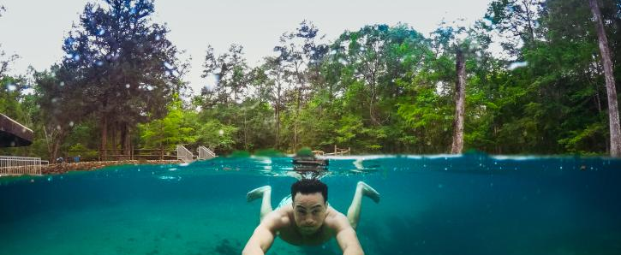
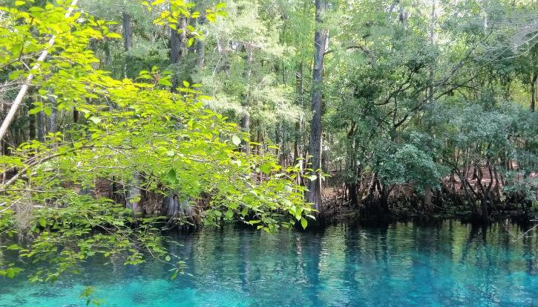
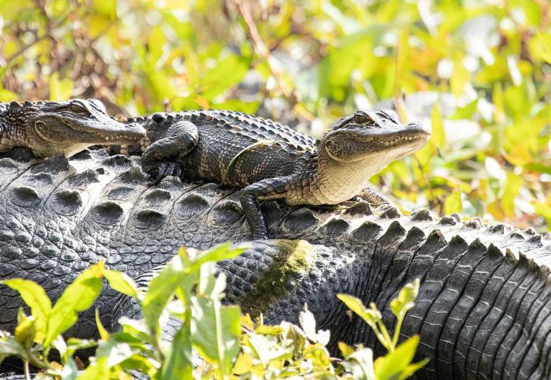
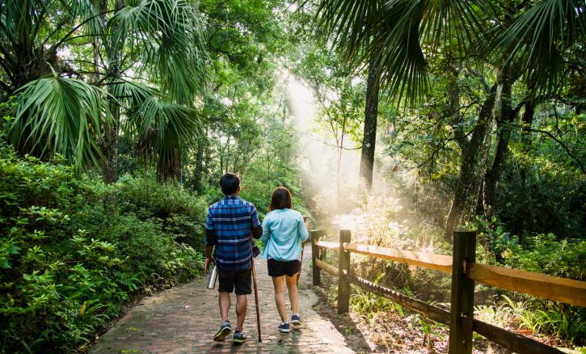

Slide 3
Notes:
BlueSky is a modeling framework. BlueSky modularly links a variety of independent models of fire information, fuel loading, fire consumption, fire emissions, and smoke dispersion.
At each modeling step, BlueSky has several different specific models from which to choose. BlueSky is not a model per se because many different modeling pathways are possible within BlueSky.

Slide 7
Title Slide
Title: Impact of Wildfire Smoke on Outdoor Activity and Florida State Parks
Subtitle: Economic and Community Outcomes in Tallahassee, Florida
Your Name and Date

Slide 8
2. Introduction
Overview of wildfire smoke impacts on air quality, outdoor activities, and local economies.
Focus on Florida state parks and outdoor recreation in Tallahassee.

Slide 9
3. Motivation
Why this study matters:
Increasing wildfire frequency and intensity.
Importance of state park revenue for local economies and community well-being.
Connection between outdoor access and mental/physical health.

Slide 10
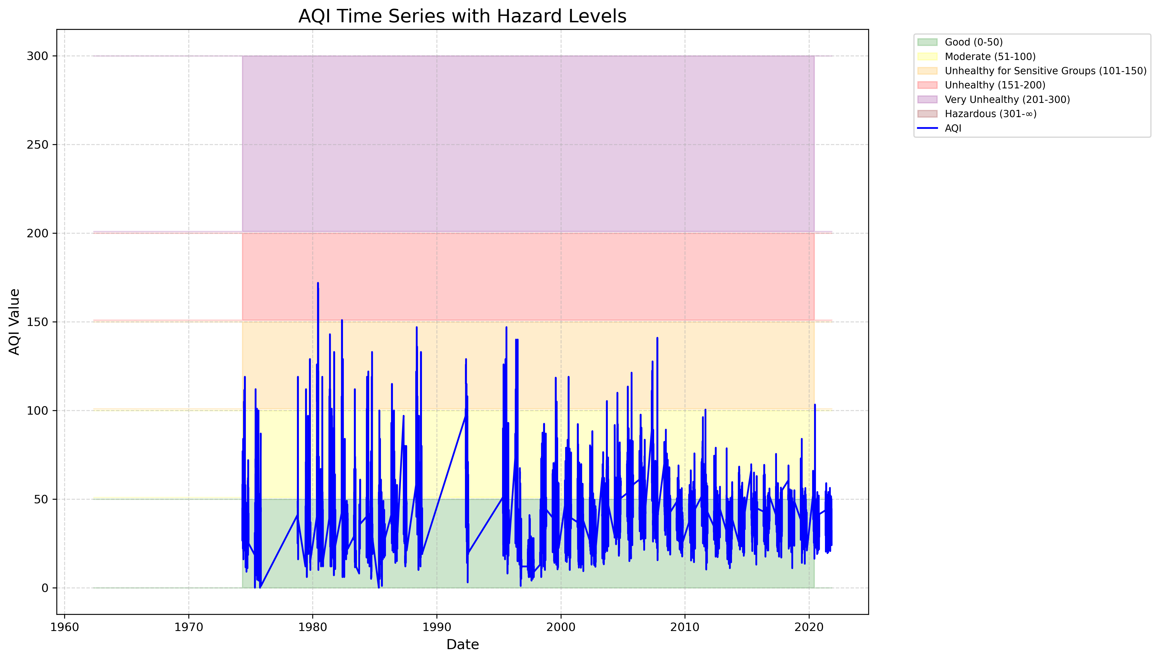
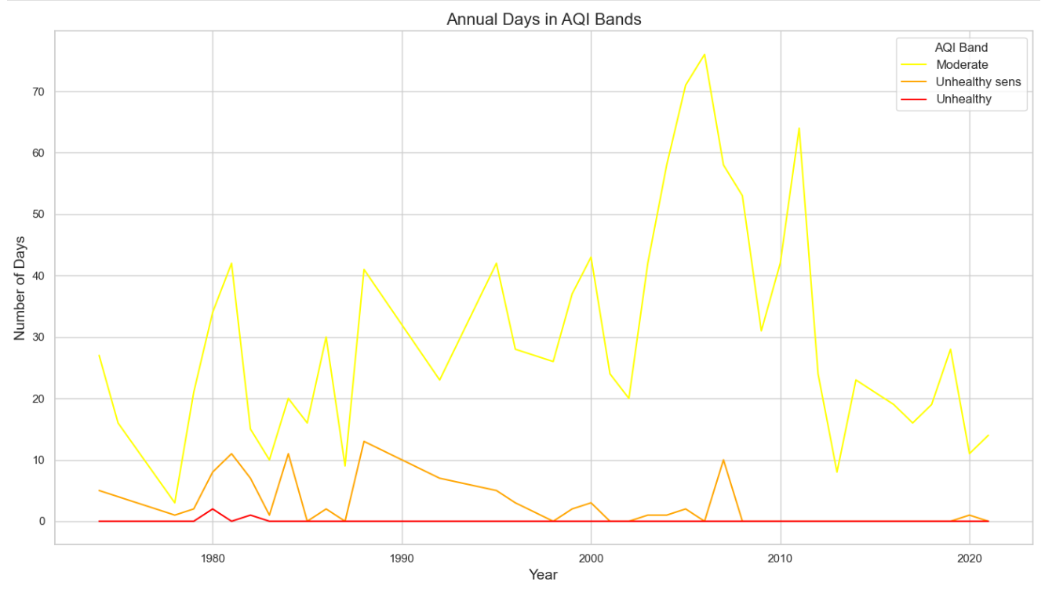
Tallahassee Historical AQI:

Slide 11
Smoke & AQI Projection:

Slide 12
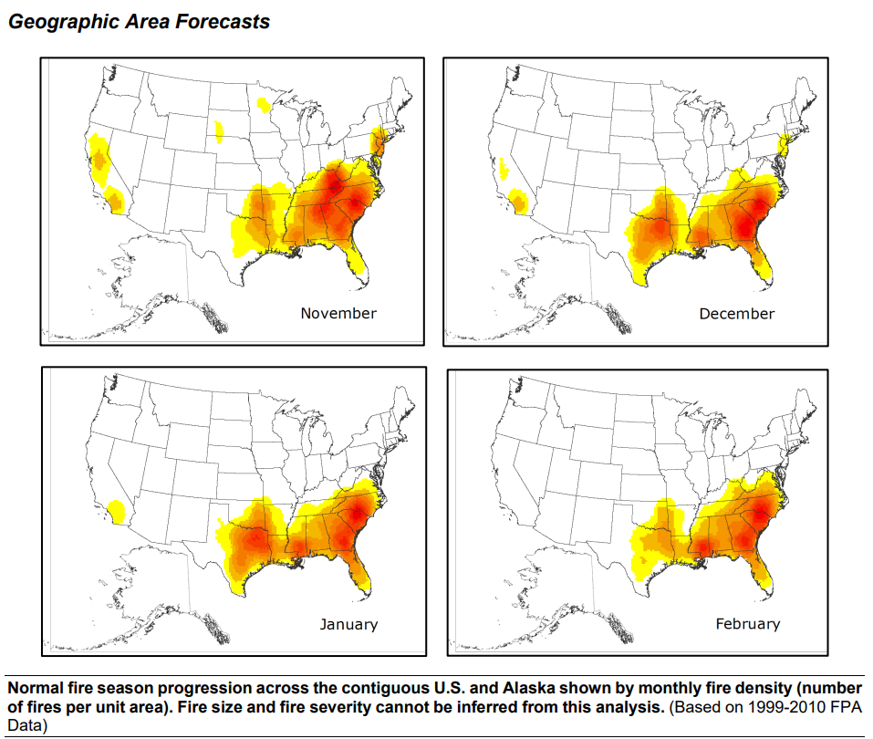
Modeling Deficiencies:
Current Smoke & AQI Model:
weak correlation between smoke model and AQI readings
Larger range and lower confidence in budgetary results
Update Assumptions:
fire season is all year in the southeastern United States
Summer is rainy season and winter is dry season
Predictive Services, National Interagency Fire Center. ‘Geographic Area Forecasts November 2024 through February 2025’, Retrieved from https://www.nifc.gov/nicc-files/predictive/outlooks/monthly_seasonal_outlook.pdf
Notes:
BlueSky is a modeling framework. BlueSky modularly links a variety of independent models of fire information, fuel loading, fire consumption, fire emissions, and smoke dispersion.
At each modeling step, BlueSky has several different specific models from which to choose. BlueSky is not a model per se because many different modeling pathways are possible within BlueSky.
Predictive Services, National Interagency Fire Center. ‘Geographic Area Forecasts November 2024 through February 2025’, Retrieved from https://www.nifc.gov/nicc-files/predictive/outlooks/monthly_seasonal_outlook.pdf
Image caption: "Smith, J. (2020). 'Urban Landscape.' [Image]. Retrieved from https://www.cityscape.com".

Slide 13
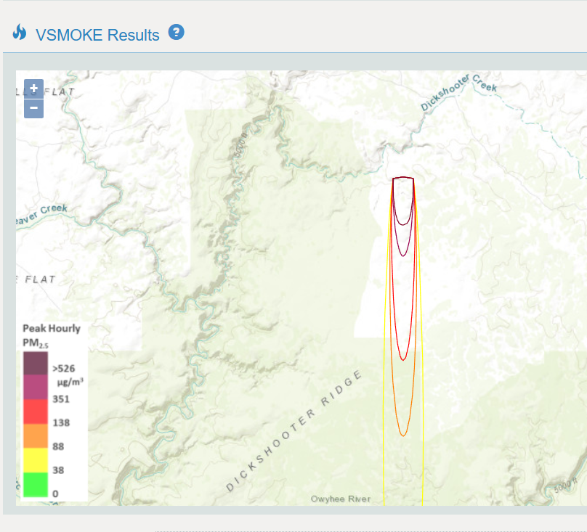
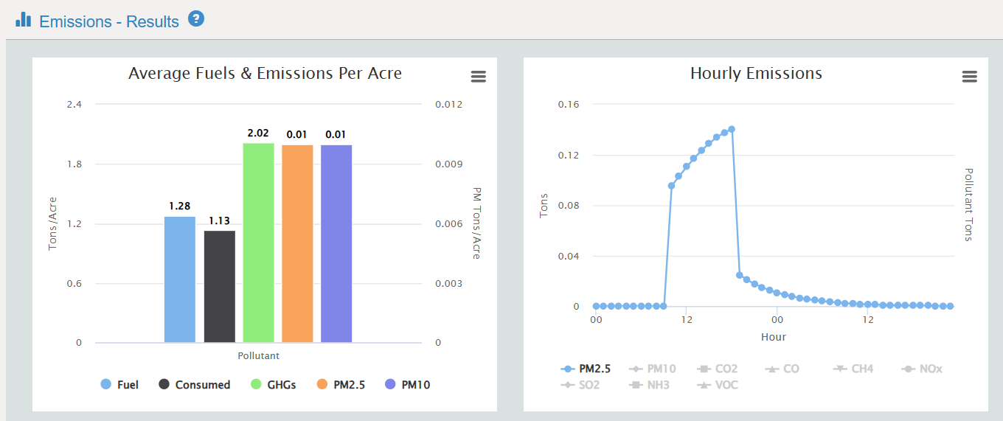
Modeling Improvements:
Shift to BlueSky for modeling
Modeling tools from the US Forest Service, EPA and Fire Sciences Labs
Incorporates wind, fuel type, fuel moisture, consumption rate, timing/duration, fire type, and seasonality
Notes:
BlueSky is a modeling framework. BlueSky modularly links a variety of independent models of fire information, fuel loading, fire consumption, fire emissions, and smoke dispersion.
At each modeling step, BlueSky has several different specific models from which to choose. BlueSky is not a model per se because many different modeling pathways are possible within BlueSky.

Slide 14
Economic Impact on State Parks
Predicted revenue losses for Tallahassee state parks due to reduced visitation.
Graph or table showing projected budget shortfalls.
Highlight local vs. tourist behavior assumptions.

Slide 15
Policy Recommendations
Suggestions for mitigating economic and social impacts:Alternative funding sources for parks.
Community programs to encourage outdoor activity during lower-smoke periods.
Public education about smoke impacts and health.

Slide 16
Recap
10. Conclusion
Recap of key findings and their implications:
Wildfire smoke impacts on AQI, outdoor activity, and state park revenue.
Importance of proactive planning and policy-making.
Final thought: Balancing economic sustainability with community well-being.

